Slide 1
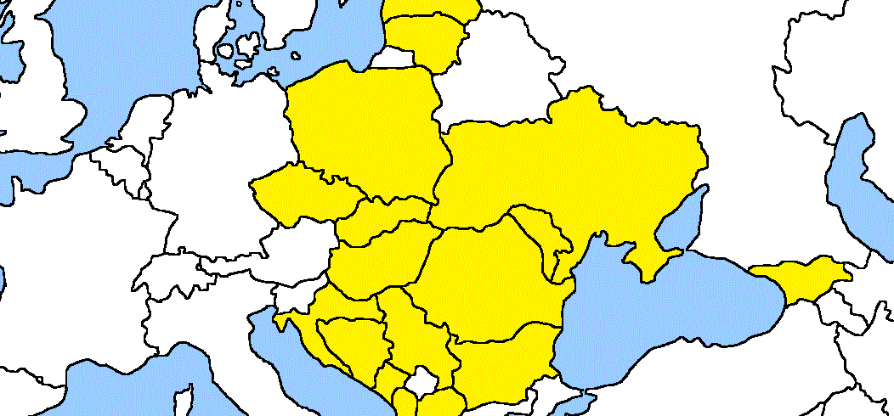

PRIVACY PROTECTION IN THE WORKPLACE
MARIYA MATEVA
TSANKO TSOLOV
Members of the
Bulgarian Commission for Personal Data Protection
18TH CEEDPA CONFERENCE
SARAJEVO, BOSNIA AND HERZEGOVINA

Slide 2
Privacy protection in the workplace, why it matters?
- The right to privacy vs. the interests of the employer
- New social and technological developments (BYOD, RFID)
Privacy issues from CPDP experience
- Video surveillance in dressing rooms
- Access control via vein-code
18TH CEEDPA CONFERENCE
SARAJEVO, BOSNIA AND HERZEGOVINA

Slide 3
Legal regulation of the privacy in the workplace
- No specific EU legislation
- Every EU member sets standards
Useful documents
- Opinion 8/2001 of the Article 29 WP: link to opinion
- The data protection and employment in the EU (Oxford University study 1999): link to study
- Fact sheet on privacy in the workplace by the Office of the Privacy Commissioner of Canada (2004): link to sheet
18TH CEEDPA CONFERENCE
SARAJEVO, BOSNIA AND HERZEGOVINA

Slide 4
Contribution of the CPDP: Privacy protection in the workplace. Guide for employees
- A comprehensive set of recommendations, rules and good practices, aiming to support individuals in the EU labour market
- Developed in the framework of a “Leonardo da Vinci” project
- A product of joint cooperation effort with the DPAs of Poland, Croatia and the Czech Republic
- Available online in Bulgarian, Polish, Czech, Croatian and English:
Privacy protection in the workplace. Guide for employees.
18TH CEEDPA CONFERENCE
SARAJEVO, BOSNIA AND HERZEGOVINA

Slide 5
Chapters of the Guide: following the employer – employee interaction
- Job search
- Recruitment procedure
- Employment period
- Data protection and termination of the employment relationship
- Employees’ rights and DPAs as a helping hand
18TH CEEDPA CONFERENCE
SARAJEVO, BOSNIA AND HERZEGOVINA

Slide 6
Employment period
- Data processing during the employment period
- Right of access to information vs. right of personal data protection
- Disclosure of information to the public
- Sensitive data processing
- Internet monitoring and video surveillance in the workplace
- Supervision techniques and methods applied by employers
18TH CEEDPA CONFERENCE
SARAJEVO, BOSNIA AND HERZEGOVINA

Slide 7
THANK YOU FOR YOUR ATTENTION!
18TH CEEDPA CONFERENCE
SARAJEVO, BOSNIA AND HERZEGOVINA

