Slide 1
Regulations Related to Video Surveillance in Georgia
The Office of the Personal Data Protection Inspector of Georgia
11.05.2016
Sarajevo, 18th Meeting of CEEDPA

Slide 2

Legislative Framework
Law of Georgia on Personal Data Protection
General regulations related to all types of data processing
Specific regulations related to video surveillance
Video surveillance of streets and public space
Video surveillance of premises of public agencies and private organizations
Video surveillance of the residential buildings

Slide 3
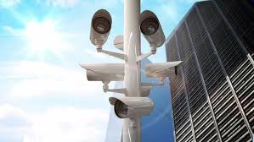



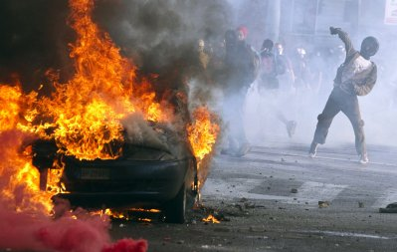

Video Surveillance in Streets and Public Space
Purpose limitation:
! Allocation of appropriate warnings signs are mandatory
! Security of video recordings should be ensured

Slide 4
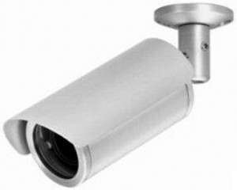

Video Surveillance in Premises of Public Agencies and Private Organizations
Purpose limitation:
Person’s security
Protection of property
Prevention of minors from harmful influence
Protection of confidential information
Video surveillance at a workplace:
if it is necessary for human security
property protection
Protection of confidential information
! these goals may not be reached by other means
! Video surveillance is only permitted to monitor outside perimeter and entrance of the building
! Video surveillance shall be inadmissible in cloak rooms and hygiene facilities

Slide 5
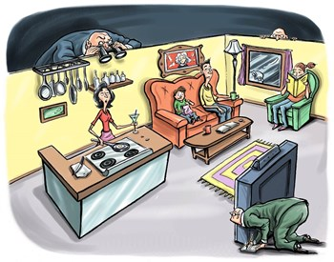
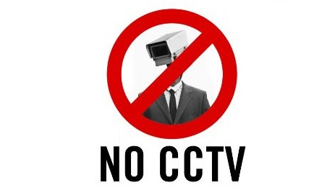
Video Surveillance of Residential Buildings
Purpose limitation:
- Personal security - Protection of property
Entrance of the building
Common spaces
Video surveillance may only conducted on the basis of written consent of more than a half of the owners of the apartments.
Residents of the building must be notified of the video surveillance system installation

Slide 6

Conducted Inspections
Related to Video Surveillance
2015:
Legitimacy of video surveillance
11 data controllers
6 data controllers also carried out audio monitoring
Citizen’s Complaints
On the initiative of the Inspector
!4 data controllers were fined
Video-audio monitoring was most frequent at service domains (retail points, pharmacies, banks)

Slide 7

Data Breaches
Revealed Breaches:
Conducting video surveillance for purposes other then prescribed by law – such as service quality control, compliance with Code of Ethics
Lack of warning signs
Conducting unnecessary audio recording for 24/7
Wide territorial coverage of video monitoring

Slide 8

Data Breaches
Existing challenges:
Timeframe of storage
Security and access to the video footages
Audio Control
Harmonization of legislation with new European standards

Slide 9


Preventive Activities
General Recommendations on Video Surveillance
Consultations

Slide 10

Draft Legislative Amendments
Video Surveillance
Obligation to determine objectives and scope of video surveillance, length of video recording, terms of access to video records, terms of their storage and destruction, mechanisms of protection of data subject’s rights
Requirements established by Law in relation to video surveillance will also apply to data processing by installed/placed automated photo equipment
Area of video surveillance is limited to the space under the usage of organization
Audio recording and audio monitoring in combination with video surveillance is allowed only in compliance with the requirements of rules prescribed for audio recording

Slide 11
Draft legislative amendments
Audio Monitoring
Specific regulation on audio recording and audio monitoring
Directly envisaged by normative act determining functions of data controller
Audio recording and/or audio monitoring is necessary for carrying out data controller’s activities
Relevant warning sign shall be placed
! these goals may not be reached by other means
Rights of the data subject to receive audio recording of the communication upon request

Slide 12



Thank You
office@pdp.ge
www.personaldata.ge
facebook.com/DPAGeorgiaOfficial
twitter.com/DPAofGeorgia

