Slide 1

Julia Sziklay:
Facial recognition – a relevant example of biometric data collection
Sarajevo, 12-05-2016
Ide kerülhet az előadás címe
Ide kerülhet az előadás címe

Slide 2

Biometric data
- ‚Biometric data' means any data relating to the physical, physiological or behavioural characteristics of an individual, which allow their unique identification, such as facial images.
- The processing of photographs will not systematically be processing of special categories of personal data as they will only be covered by the definition of biometric data when being processed through a specific technical means allowing the unique identification or authentication of an individual
- Processing biometric data on large scale filing system present specific risk.
(General Data Protection Regulation)

Slide 3
Facial recognition
Multiple kinds:
face detection: software in phone cameras („it’s Mum”)
facial characterization: discerns demographics of a face, smart billboards („a teenager white male”)
verification: activating a laptop or phone only when the camera sees an approved visage
identification of an unknown person: a database connects a stranger’s face to a name or other identifier
A. online form („software identifies you from a picture uploaded to Facebook”)
B. offline form („software identifies you by taking your picture while you’re just walking around”)

Slide 4
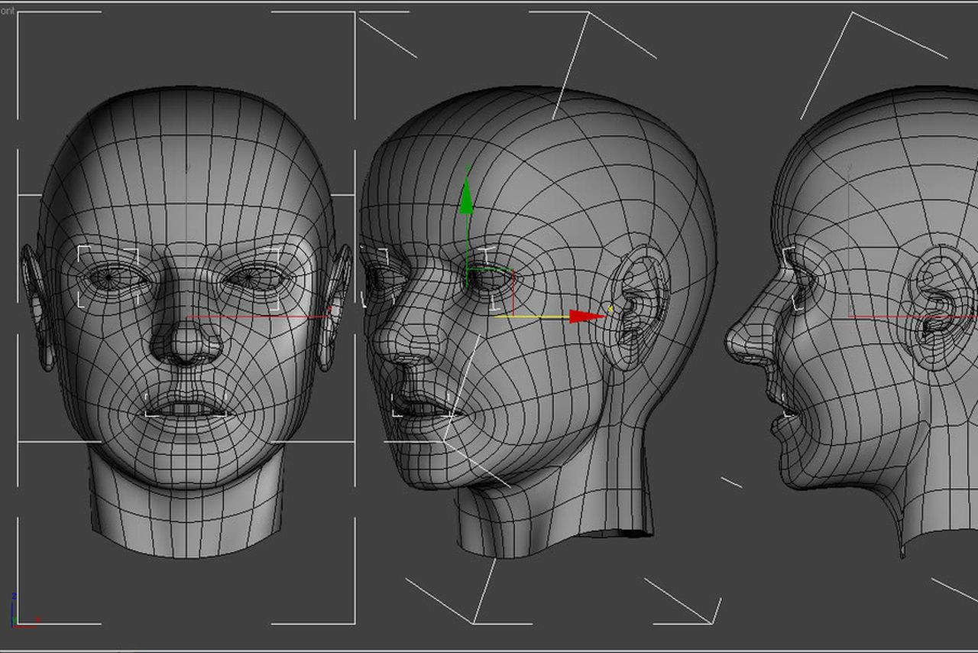
Hungary
The technology is widely
used to identify known or
suspected criminals at
entry points
such as airports.
Hungary: nationwide
Introduction
From 1 January 2016 onwards, facial data of residents (and in some cases also foreigners wishing to cross the borders) of Hungary will be stored in a database which can be accessed by Hungarian law enforcement authorities. The encoded profiles, generated from identification photos, will be used by a facial recognition programme and may be combined with other databases.

Slide 5
Data protection concerns and solutions
The general and uniform personal identification mark (personal number) for unrestricted use is unconstitutional. (1991)
Mass use of covered/secret surveillance seriously harms privacy.
The big governmental databases shall not contain biometric profile reference data bases.
A separate and closed governmental database shall set up.
The biometric database shall not include personal data (names, addresses etc.), the persons can be identified by a so-called “contact or hash-code” and the forwarded images are immidiately deleted after the codes are created.
In case of request the forwarded image is transformed into a new code which is compared with the stored contact codes. I case of a hit the authorised authorities can contact the big governmental database.
Authorities with requesting rights are limited (police, secret services, the anti-terrorist super police)

Slide 6
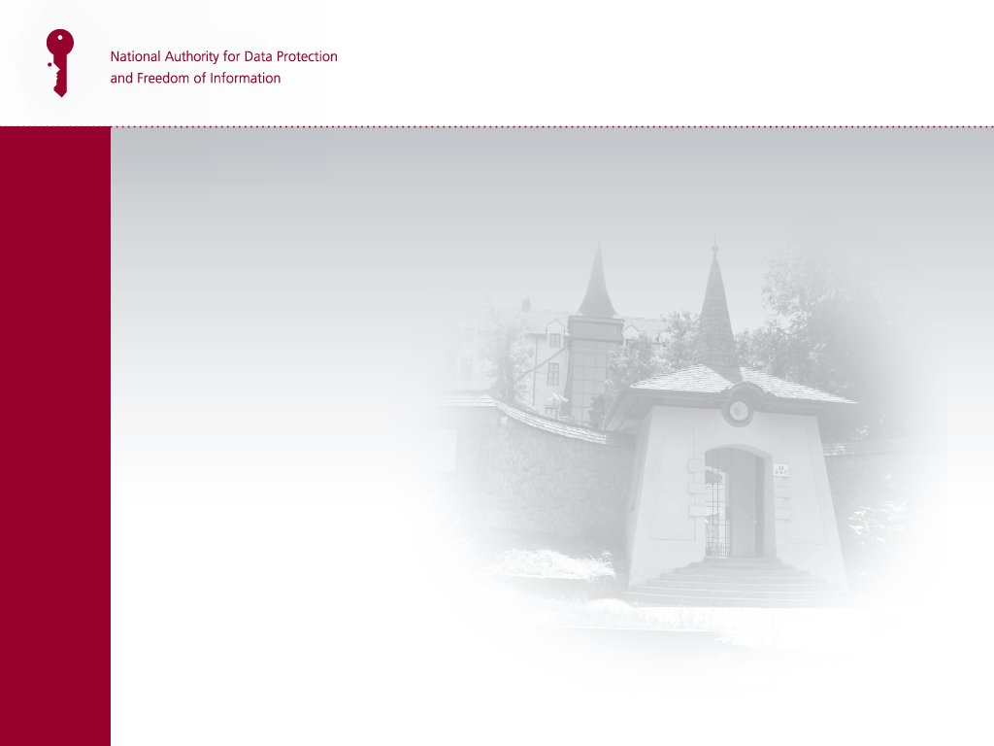
Thank you for your attention!
NAIH address:
H-1125 Budapest,
Szilágyi Erzsébet fasor 22/c.
H-1530 Budapest, Pf. 5.
Tel.: +36 391-1400
Fax: +36 391-1410
ugyfelszolgalat@naih.hu
privacy@naih.hu
www.naih.hu

